Slide 1
EXPERIENTIAL LEARNING
DEEPA R.P.
Associate Professor
N.V.K.S.D. College of Education,
Kanyakumari District , TamilNadu

Slide 2
Learning is a continuous process.
Z generation learners are taught by X and Y generation teachers
Mostly the teaching –learning process is limited to understanding level within four walls of class room , and learning could not be experienced.
But
Learning should be experienced and challenging enough to develop 21st century skills namely problem-solving critical thinking, decision-making etc.

Slide 3
Educational thoughts
“For the things we have to learn before we can do them, we learn by doing them.” Aristotle
You cannot cross the sea merely by standing and staring at the water Tagore
“Sound experience involves continuity
between learners and what is learned” John Dewey

Slide 4
NCF 2005
The national curriculum framework (2005) has put greater emphasis on designing tasks-based learning experiences that challenge students thinking and encourage independent thought and action.
“Children learn in a variety of ways—through experience, making and doing things, experimentation, reading, discussion, asking, listening, thinking and reflecting, and expressing oneself in speech, movement or writing—both individually and with others. They require opportunities of all these kinds in the course of their development”.(NCF, 2005 page 34)
.

Slide 5
Hence the policy makers, educationists and supporting educational governing bodies - UNESCO , NCERT, CBSE and MHRD recognised the need for active student-oriented teaching and learning by EXPERIENTIAL LEARNING

Slide 6
BASES OF EXPERIENTIAL LEARNING
John Dewey (1938), Jean Piaget (1966), Lev Vygotsky(1932) David Kolb (1984), and Wells (1995) have greatly contributed to experiential learning.

Slide 7
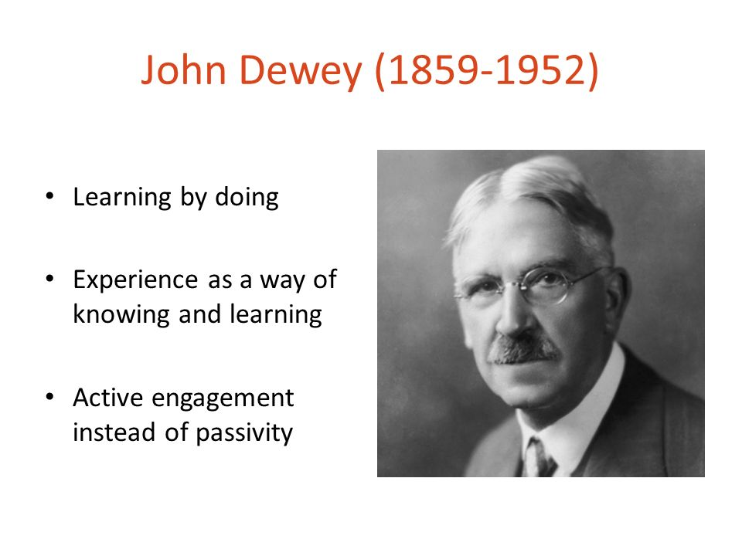

Slide 8
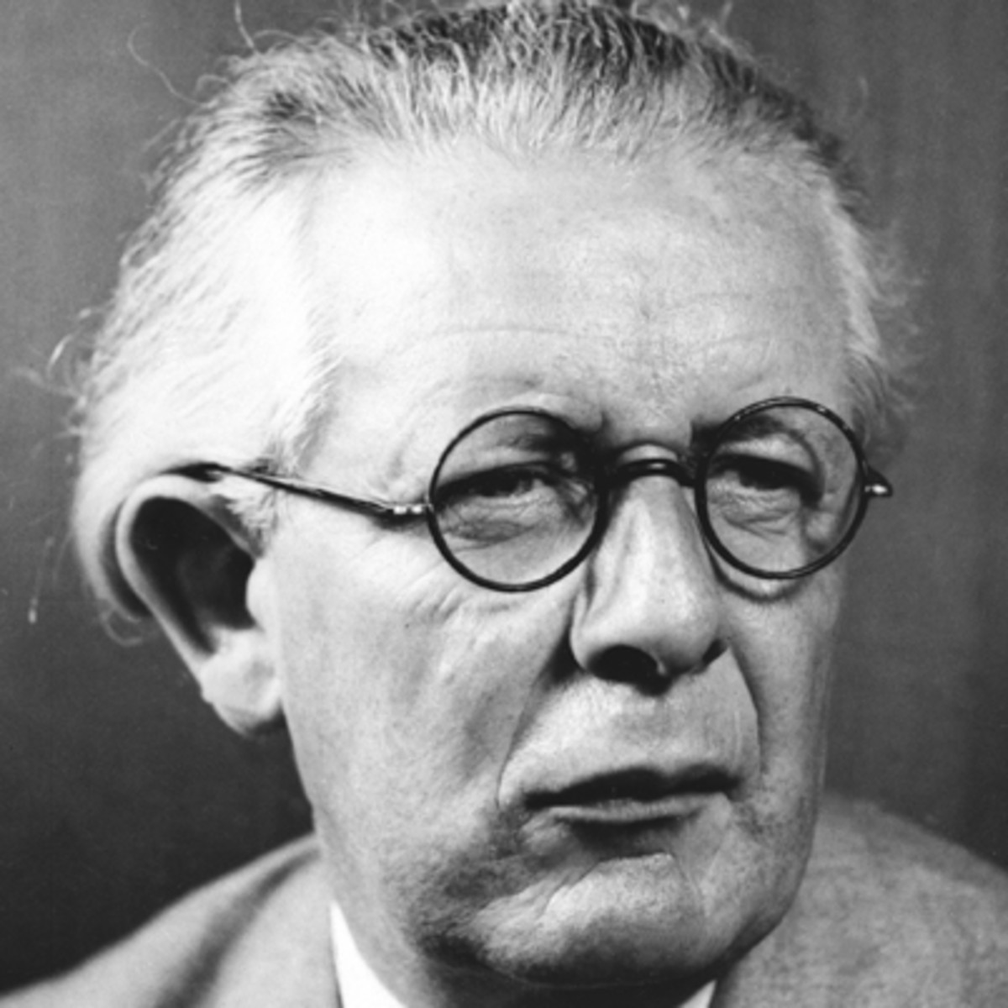
JEAN PIAGET (1896–1980)
Children are active learners.
He found out cognitive theory
They construct new knowledge
as they move different cognitive stages
( with their previous knowledge).

Slide 9
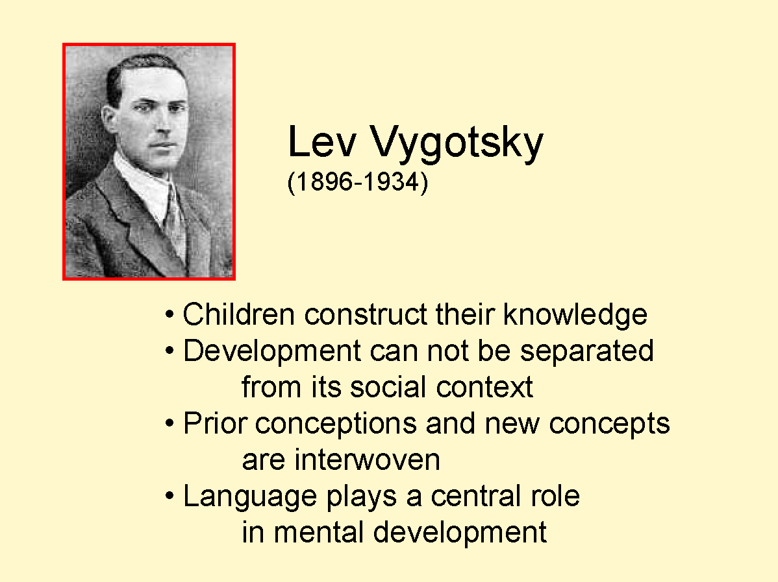

Slide 10
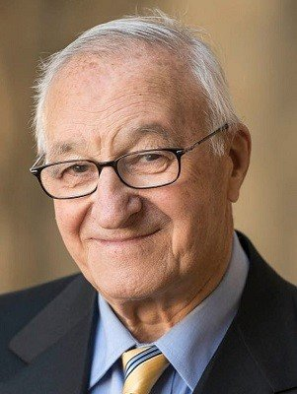
Albert Bandura
Bandura is known for his social learning theory.
He claims that children continually learn desirable and undesirable behaviour through observational learning.
He suggests that an individual's
environment, cognition,
and behaviour are responsible
for active learning.

Slide 11
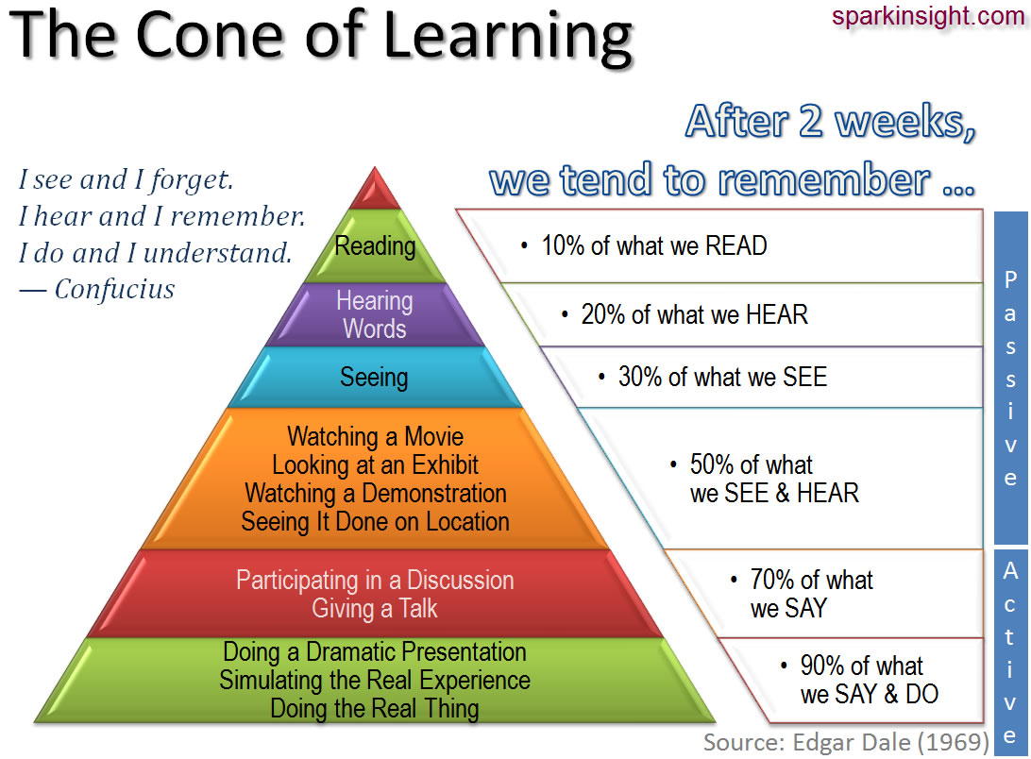

Slide 12
WHY – SIGNIFICANT
Experiential learning is the theme for teacher training in CBSE for Session 2019-20
Accelerates Learning
Provides a Safe Learning Environment
Bridges the Gap Between Theory and Practice
Produces Demonstrable Mindset Changes
(“ swimming, cannot be learned by reading about it”)
Increases Engagement Levels
Exceptionally effective for retention
Enables Personalized Learning

Slide 13
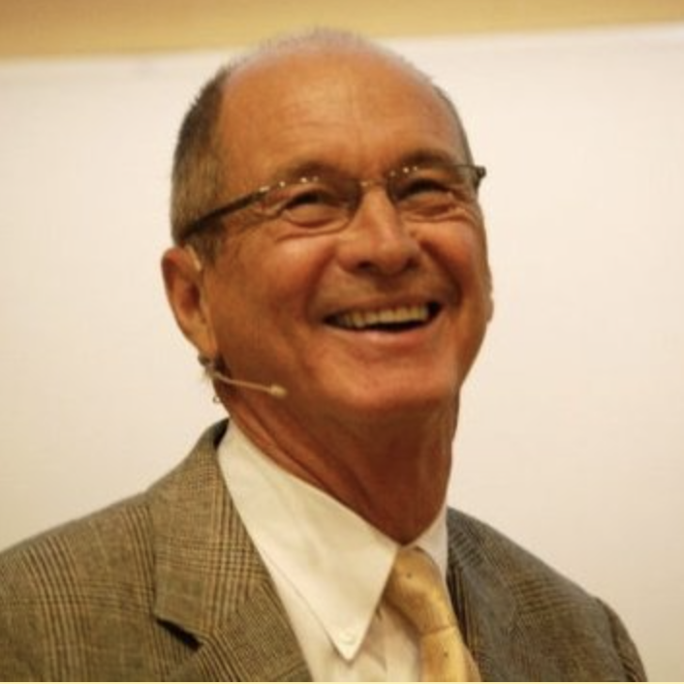
EXPERIENTIAL LEARNING
Experiential learning involves
learning from experience
Proposed by David Kolb
He emphasizes how experiences,, including cognition, environmental factors, and emotions, influence the learning process.

Slide 14
Experiential learning engages students in the classroom in interactive activities that allow them to gain experience and provide them with opportunities to reflect, analyze and reconstruct concepts and new information

Slide 16

EXPERIENTIAL LEARNING
learning from experience.
learner-centered
learners accountable for their own learning
Own pace

Slide 17
able to evaluate, think critically, make decisions and master knowledge by constructing it.
The teacher is a facilitator .
Learning experience may be cooperative, collaborative or independent,
Encourage the students to work together
learn how to question and evaluate evidence rather than accepting truths communicated by their teacher.

Slide 18
“Learning is the process whereby knowledge is created through the transformation of experience”
(Kolb, 1984, p. 38).

Slide 19
Students get mastery over their learning, if they apply learned concepts to new situations.
Build knowledge from their experiences provided to them.

Slide 20
David Kolb (1984) A complete learning cycle happens only when a learner goes through all the stages of learning that is cognition, perception, behaviour, experience and reflection.
knowledge, attitude and skills are achieved through concrete experience, reflective observation, abstract conceptualization, & active experimentation.

Slide 21
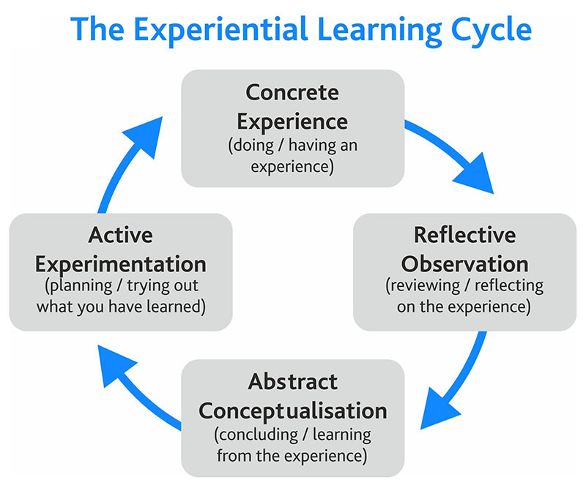

Slide 22
I. the learners are provided with concrete experience.
This could be done by field visits, community survey , awareness programm, case study or role play, or an experimentation
II. the learner takes some time for reflective observation.
The learner asks of the experience:
What did I observe?
What was I aware of?
What does this experience mean to me?
How might this experience have been different?

Slide 23
III. the learner uses insights gained through the reflective observation to create an abstract conceptualization.
the learner asks:
What principle seems to be operating here?
What general ‘rule-of-thumb’ have I learned here?
What new understanding does this experience reveal about myself, or people, or how things work in particular situations?

Slide 24
IV. the learner applies the new learning through active experimentation.
The learner asks,
What will I do next time?
How will I adopt this principle for other contexts?
The new “principle” is tested out in similar situations,
then in different situations, and the learner continues to revise and reshape the learning based on what happens through experimenting with it.

Slide 25
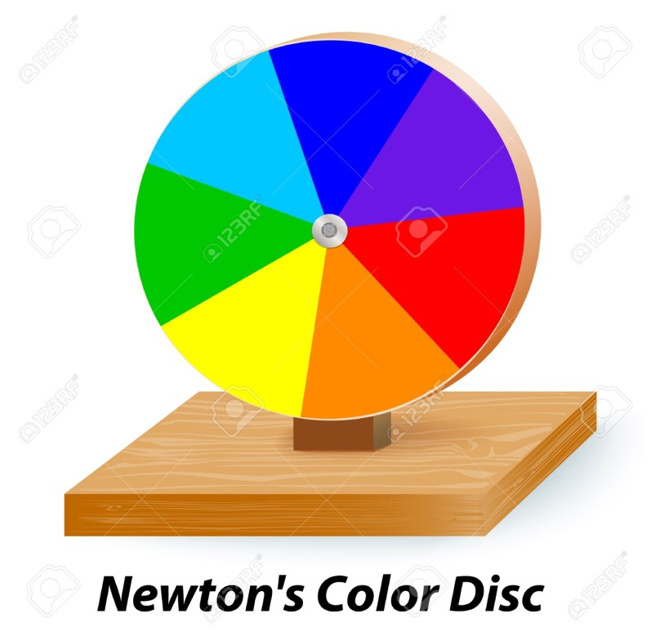
Eg Newtons’ disk
Bicycle Riding

Slide 26

Eg observing the experiment through video and reading the text

Slide 27
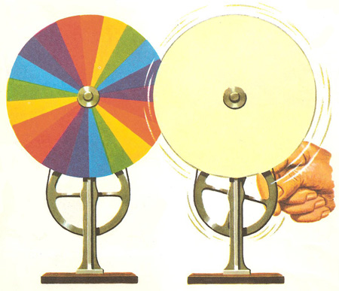
Make a newton’s disk and on rotation found that white light

Slide 30
Steps
I. SETTING THE STAGE/ START THE LESSON
1. Checking prior knowledge | check what learners already know (Questions)
2. Pre- Activity Phase | role play , activity, teaching aids, create a situation based on the lesson
3.Resources required | Ppts videos textbook writing materials teaching aids

Slide 31
B.IMPLEMENTATION OF THE LESSON
i.Sparking curiosity (Create interest ) | Vidoes,ppt & teaching aids,story telling (vocabulary building)
2.Providing experience (Experiential learning strategies) Values & life skills(Concept, Term, Facts) | Activities, group work, pair work, doing experiments, role play,
3.Drawing inferences (Record,document their observations, learnig from tasks) | Group discussion, (subject Enhancement)

Slide 32
C. CONCLUSIVE PHASE
Conceptualization | Through questions Students assimilates answers from inferences Solving problems
Connecting to real life | Students are asked to do a / reports / reflection on importance of learned lesson in their daily life
Extended learning (Subject Connect) | Field visits , projects, awareness programme, production of materials, writing assignment,

Slide 33
D. Assessment
facilitator check and ensure that
learners have constructed knowledge and
learning objectives have been achieved (formative
assessment, home works, assignments )
E. My Own Learning (Post-Lesson Reflection)
Reflects his teaching skills through RUBRICS
Challenges /problems faced by the facilitator while planning and implementing the lesson plan
Feedback from the students

Slide 34


