Slide 1
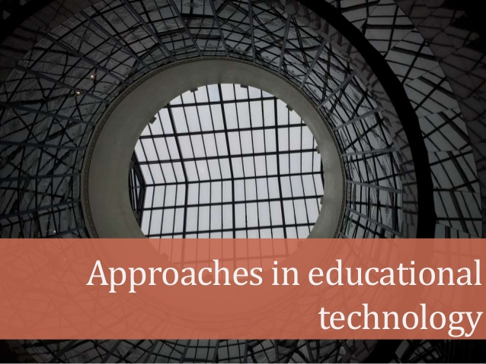

Slide 4
HARDWARE APPROACH
It refers to the use of machines & other mechanical devices in the process of education.
Its origin lies in the application of “physical science” to education & training system.
The process of teaching-learning has been gradually mechanized through the use of teaching machines, radio, television, tape recorder, video-tape, projectors etc.
The teacher can deal with a larger & larger group of students at the same time by his discourse through these machines.

Slide 5
Hardware approach mechanises the process of teaching so that teachers would be able to deal with more students with less expenditures in educating them.
Human knowledge has three aspects:
Preservation,
Transmission and
Development.

Slide 6
Preservation
The history of preservation of the knowledge is believed to exist since the printing machines started.
The knowledge is preserved with these machines in the form of books which are shelved in the libraries, tape recorders and films.

Slide 7
Transmission
The second aspect of human knowledge is its transmission.
A teacher can impart knowledge himself to his pupils.
Now a days, transmission of the knowledge is supported by machine like mike, radio and television.
With these, thousands of pupils enjoy this home-delivery of such benefits.

Slide 8
Development
The third aspect of human knowledge is its development.
the collection and analysis of data.
For this purpose, presently the researcher uses the electronic machines and computers.
In short, the teaching process has been mechanized. The mechanization of teaching process is termed as the Hardware Approach.

Slide 9
SOFTWARE APPROACH
Software approach refers to the application of teaching- learning principles to the direct & deliberate shaping of behavior.
Its origin lies in the application of “behavior science” to the problems of learning & motivation.
This view of educational technology is closely associated with the modern principles & theories of teaching.
Models of teaching, theory of instruction, theory of teacher- behavior & principles of programmed learning.
It is characterized by task analysis, writing, objectives in behavioral terms, selection of the appropriate teaching strategies, reinforcement for correct responses & continuous evaluation.

Slide 10
Word processing, database, spreadsheet, telecommunications, presentation, authoring, graphic paint programs.

Slide 11
used the principles of psychology for modifying his behaviour
The pioneering work in software approach was done by Skinner and other behaviourists.
also termed as Instructional Technology or Teaching Technology or Behavioural Technology.
Newspapers, books, magazines, Drill and practice, tutorials or computer-based instruction, and simulations, educational games, flash cards may also form part of software.
concerned with teaching objectives in behavioural terms, principles of teaching, methods of teaching, reinforcement of instructional system, feedback, reviews and evaluation.

Slide 12
Software approach tries to develop all the three basic components of technology.
Input
Process and
Output.

Slide 14
Webster’s dictionary defines a system as “a regularly interacting or independent group of items forming a unified whole.”
In education, system consists of pupils, teachers, curriculum, content and evaluation of instructional objectives. The teaching-learning process is viewed as communication and control taking place between the components of a system.
In this case, the system is composed of a teacher, a student and a programme of instruction, all in a particular pattern of interaction.

Slide 15
In the systems approach to instruction, the teacher has to plan completely the utilization of selected resource material and the classroom activities. The teacher should have a good overall view of the subject, know his/her limitations, know all about his/her pupils and the individual differences in their learning capacities and plan accordingly.

Slide 16
Major steps
1. Formulating of specific instructional objectives to be achieved and defining instructional goals, 2. Deciding appropriate media to achieve these goals, 3. Defining learner characteristics and requirements, 4. Selecting appropriate methods suitable for effective learning to take place, 5. Selecting appropriate learning experiences from available alternatives,

Slide 17
6. Selecting appropriate materials and tools required, 7. Assigning appropriate personal roles for teachers, students and supporting staff, 8. Implementing the programme, 9. Evaluating the outcome in terms of original objectives measured in student performance and 10. Revising to improve efficiency of the system to improve students’ learning.

Slide 18
ADVANTAGES OF SYSTEMS APPROACH
helps to identify the suitability of the resource material to achieve the specific goal.
ii. Technological advance could be used to provide integration of machines, media and people for attaining the defined goal.
iii. It helps to assess the resource needs, their sources and facilities in relation to quantities, time and other factors.
iv. It permits an orderly introduction of components demonstrated to be required for systems success in terms of student learning.
v. It avoids rigidity in plan of action as continuous evaluation affords desired beneficial changes to be made.

Slide 19
Thank you
Dr.Deepa. R.P.
Assistant Professor

