Slide 1
Dr.Deepa R.P
Assistant Professor
N.V.K.S.D. College of Education (Autonomous) Attoor

Slide 2
Skill of blackboard writing

Slide 3
SUGGEST THE WAYS TO MAKE BLACKBOARD WRITING EFFECTIVE?

Slide 4
Blackboard is one of the most important tools in classroom teaching.
Effective use of Blackboard increases the effectiveness of teaching.
Effective visual aid
Provides clarity in understanding concepts
Draws attention of students at relevant points
Presents holistic picture of the content

Slide 5
Components
Legibility
Size and alignment
Highlighting main points
Utilization of the space
Blackboard summary
Correctness
Position of the teacher and
Eye Contact with the pupils
Cleaning the blackboard

Slide 6
1.LEGIBILITY
Distinct difference between letters
Adequate space between letters
Adequate space between words
Slant of the letter nearly vertical
All letters of the same size
Size of the letters large enough to be read
Thickness of the line uniform

Slide 7
2.SIZE AND ALLIGNMENT
NORMAL in size ,neither too big nor too small
Adequate spacing between WORDS
No over writing
Continuity in the points
Simplicity

Slide 10
3.HIGHLIGHTING MAIN POINTS
Proper use of color chalk
Appropriate presentation of illustrations and diagrams
Underlining only the important points
Focusing the relevant matter

Slide 12
4.UTILIZATION OF SPACE
Systematic planning of space
Spacing to exhibit the sequence of the items being presented
Adjustment of space for presenting related items in totality

Slide 13
POSITION OF THE TEACHER

Slide 14
EYE CONTACT WITH PUPIL

Slide 15
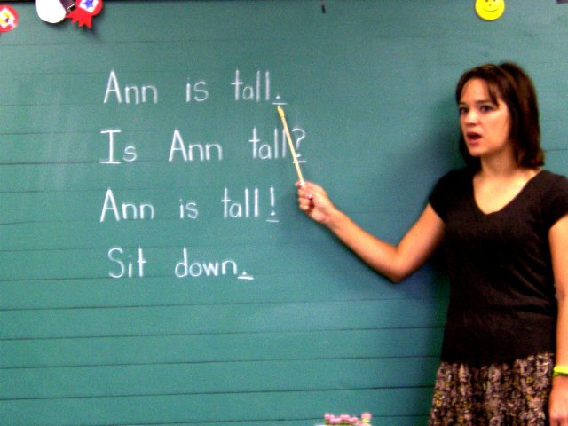

Slide 16
DONOT’S

Slide 17
CLEANING THE BLACKBOARD

