Slide 1
LIFE SKILLS FOR SMART LIVING
DR DEVIKA.S
ASSISTANT PROFESSOR,
N.V.K.S.D.COLLEGE OF EDUCATION,
ATTOOR

Slide 3
Hey…….

Slide 4
After
all
its just …..
a
FOUR
lettered word……!

Slide 5
Why make it complicated

Slide 7
This is life…….
So please don’t make it complicated

Slide 8
1.Life is SIMPLE……..Keep it SIMPLE
Don’t make it complicated…..PLEASE

Slide 9
My version of LIFE
It’s a GIFT to us even without our knowledge….
By our parents?
By God ?
Karma?
Anything else?
What ever we believe …..its a PRECIOUS GIFT

Slide 10
Accept
your
life
as
a
GIFT……

Slide 11
Because it is offered to us by somebody even without our knowledge
So if we disregard it ….then we are dishonouring the givers……

Slide 12
We have to safeguard in all our possible
means-
Be it
physical being,
Biological being or
mental wellbeing

Slide 13
Don’t insult you
Don’t underestimate you
Don’t degrade you
Don’t disrespect you

Slide 14
Then what………….

Slide 15
Respect you
Love you
Give value to you ….
You are a worthy individual specially selected to live in this world…..

Slide 16
Life Skills
Life skills are behaviours that enable individuals to adapt and deal effectively with the demands and challenges of life.

Slide 17
What of Life skills
Life skills have been defined by the World Health Organization (WHO) as “abilities for adaptive and positive behaviour that enable individuals to deal effectively with the demands and challenges of everyday life”. ... They help individuals accomplish their ambitions and live life to the fullest potential.

Slide 18
10 core life skills laid down by WHO
Self-awareness
Empathy
Critical thinking
Creative thinking
Decision making
Problem Solving
Effective communication
Interpersonal relationship
Coping with stress
Coping with emotions

Slide 19
LIFE SKILLS in Nutshell
facilitates our better living in this everyday life of ours
Helps for better adaptation
develops positive behaviour/attitude/outlook towards life
enable to deal effectively with the demands and challenges of life..
To live life to the fullest…..

Slide 20
Contd…..
develops psychosocial competency
Empower you

Slide 21
Specifically
It is not preparing for life……is to equip you to meet the challenges of everyday life.
It helps you to learn from your experiences.

Slide 22
Why of Life skills
Develop social skills
Develop interpersonal skills
Cope with the demands of everyday life.
Build self-confidence,
Encourage critical thinking,
Foster independence
Help to communicate more effectively.
Live life to its maximum best

Slide 23
How to LIVE SMARTLY

Slide 24
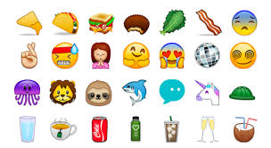
Self awareness

Slide 25
an awareness of one's own personality or individuality
Awareness and recognition of one's environment , body(physical ,biological ), lifestyle etc.
What you like ,what you do not like
Awareness of ones own strength, weakness, potential,caliber,attitudes ,values ,likes etc
Knowing about oneself….who are we…

Slide 26
Communication skills

Slide 27
Communication skills are needed to speak appropriately and according to situation.
Communication can be verbal, nonverbal or written
If the message you want to convey is broken, then everything would be upside down.
Be very particular and clear in communicating messages.

Slide 28
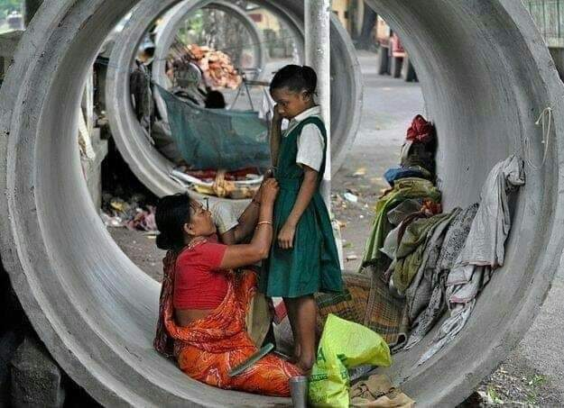
Accept life as it is

Slide 29
face the reality (it is not easy ),
Accept the reality.
Neither try to build castles in the air nor live in it…come to the reality…face boldly…it builds your confidence..
but understanding ,accepting and working with reality can make you happier in the present and can lead to a better future.

Slide 30
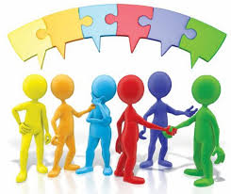
Interpersonal skills

Slide 31
we use it in our every day life to communicate and interact with others, including listening, and speaking
To build relationships
Its highly associated with emotional intelligence

Slide 32
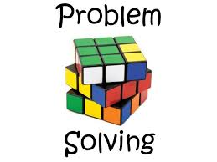
.

Slide 33
Learn how to solve problems effectively
act of defining a problem; determining the cause of the problem; identifying, prioritizing, and selecting alternatives for a solution; and implementing a solution

Slide 34
Decision Making

Slide 35
A cognitive process
resulting in the selection of a decision among several possible alternative options.
Decision-making is the process of identifying and choosing alternatives based on the values, preferences and beliefs of you (the decision-maker.)

Slide 36
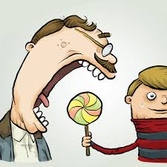
Self -Control

Slide 37
ability to regulate one's emotions, thoughts, and behaviour in the face of temptations and impulses.
is a cognitive process
Important to achieve specific goals.

Slide 38
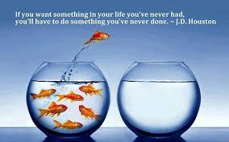
Taking challenges

Slide 39
A willingness to take on challenges in spite of setbacks is most important for success.
avoiding challenges prevents us from achieving our potentials

Slide 40
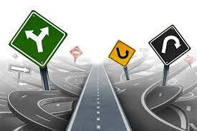
Stay focused

Slide 41
To focus means to direct your time, energy and attention to the task you are engaged with.
Things that are outside your selected area of focus become unimportant
Very important to be successful

Slide 42
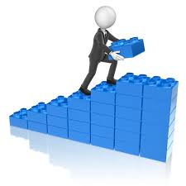
Self-Directed

Slide 43
self-determination
the ability to regulate and adapt behaviour to the demands of a situation in order to achieve personally chosen goals and values

Slide 44
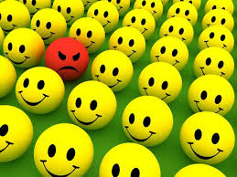
Anger management.

Slide 45
Anger is frequently a result of frustration, or of feeling blocked or thwarted from something the that you feel is important.
Anger management for anger prevention and control.
deploy anger successfully.

Slide 46
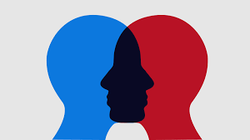
Empathy
.

Slide 47
capacity to understand or feel what another person is experiencing from within their frame of reference,
the capacity to place oneself in another's position

Slide 48
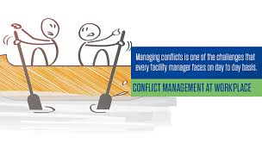
Conflict management

Slide 49
process of limiting the negative aspects of conflict while increasing the positive aspects of conflict.
enhances learning –(personal /professional/academic) effectiveness

Slide 50
Time-Management

Slide 51
process of planning and exercising conscious control of time spent on specific activities, especially to increase effectiveness, efficiency, and productivity.
Helpful for syatamatic living..
habit of diary writing

Slide 52
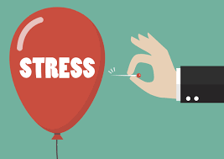
Coping with stress

Slide 53
Coping involves adjusting /tolerating to negative events or realities while attempting to maintain your positive self-image and emotional equilibrium.
occurs in the context of life changes that are perceived to be stressful.
associated with negative life changes,

Slide 54
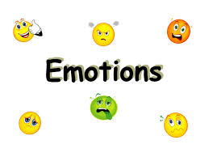
Coping with emotions
.

Slide 55
coping with emotions means recognizing emotions within us and others
being aware of how emotions influence behaviour.
Intense emotions like anger or sadness can have negative effects on our health if we do not respond appropriately

Slide 56
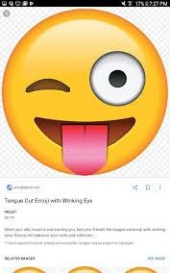
Some more….
Don’t go for petty arguments…(its sheer wastage of time)
Try to learn from everything around you..
Accept with grace with whatever we have..
Don’t compare your life with others…they have their own..you have yours….your are unique and you are special

Slide 57
Learn from your experiences..
Enjoy every moment of your life…how we are living is more important than how many years we lived..
Set definite ,achievable goals in your life. Live to accomplish it…then life will be systematic and successful…

Slide 58
Formula of success
Hard work+ achievement=Success
Hard work +failure= Success
No hard work + achievement =luck
No hard work + no achievement =failure

Slide 59
Live your life so that others would be tempted to live a like you( secretly to say try to be a role model)
Live meaningfully….live purposefully…
Enjoy the praise(don’t expect that for all the good deeds you are rewarded)…but accept criticism with grace.
Do your duties and responsibilities of different roles assigned to you

Slide 60
Live like a twinkling bright star rather than fuming to ashes over your problem
Grow daily and achieve everyday success…
Be it from
Bad Good Better Best

Slide 61
This time too shall pass…So don’t get over excited to your happiness or depressed over with your problems
Have tolerance for change..

Slide 62
To conclude…
In a constantly changing environment, having life skills is an essential part of being able to meet the challenges of everyday life. ... To cope with the increasing pace and change of modern life, we need life skills to deal with our stress and frustration and lead a life smartly.

Slide 63
Go smart from today….
Wishing you all a smart life

