Slide 1
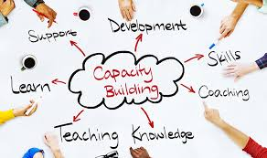
Soft Skills as an integral Unit for Capacity Building among Academia
Dr Devika.S
Assistant Professor
N.V.K.S.D.College of Education,Atoor,Kanniyakumari District,TamilNadu.

Slide 2
Delimiting Academia
Academia actually is the environment or community concerned with the pursuit of research, education, and scholarship.
Here ,I would like to delimit academia as the community of teachers of Education,prospective teachers,prospective teacher educators and research scholars of education as we are from teacher education backgrounds.

Slide 3
Moving into the Soft Skills ….
Moving into the discussion of my topic “Soft Skills “ I would like to start by recognizing the significance of education.As we all know, Education has been recognized as a central element in a nation’s development. It is a social service and is best regarded as an instrument for social change.It uplifts the standards, promotes cooperation and maintain harmony in the society.

Slide 4
Education signifies..
Humanity has entered a new epoch in the history of civilization especially in the post Pandemic Era. Moreover,Globalization ,Privatisation ,Decentralisation ,cyber age’ , ‘space age, what not are occurring at a lightning speed in every corner of the earth.A new consciousness has emerged about the roles that individuals ,institutions and nations play in new millennium. In the world based on science and technology,digitilisation and online learning it is education that determines the level of anything including the prosperity,security and welfare of human civilisation.

Slide 5
The reality…!!!
Hence there is supposedly more ‘Education’ now.
But is our current teacher education system tailored enough to prepare our students to survive in this cut throat competitive world and to succeed living as a cosmopolitan citizens with a global perspective?

Slide 6
Personal view
The answer shall be a big YES or No
But Personally speaking,,wehave to do something more

Slide 7
Gradual pace towards soft skills..
Moreover the environment around us is more dynamic than ever before. Competition is everywhere and we are finding it difficult to meet the challenges posed by the dynamic environment. Especially with the teacher community. Our community is in a crucial period. Strained interpersonal relations, dearth of motivation ,lack of critical thinking etc are the dilemma that are frequently observed these days among the whole of the teaching community. Hence our teachers,prospective teachers,prospective teacher educators,research scholars in education should be trained,taught ,motivated to succeed and solve problems to have peace for a healthy and happy life.

Slide 8
Need for soft skills
The teachers are the social engineers and are behind moulding the future of our nation and their importance cannot be neglected.They are going to face the new global challenges posed by the dynamic environment.If they are properly empowered ,they will be able to overcome the adversities in their life to become successful and capable of making a balanced social life. They are to be made powerful to make decisions necessary to lead a fulfilling,productive life and to feel better about themselves by developing greater confidence. Teachers and Students must be encouraged to learn more willingly to face the challenges they come across in their lives.Therefore measures need to be shelled out to facilitate and train students to turn adversities into oppurtunities to reform themselves to meet the upcoming universal challenges.

Slide 9
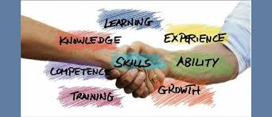
Why soft skills….???
Employability is the greatest factor for every upcoming modern teacher. To get a good job a student teacher should have both academic skill and soft skill .Academic skill is our knowledge. Transferring that knowledge into application is the most important factor which is supplemented by soft skills.These skills learnt by them today will help them in the future. The schools of education ought to prepare students both with the cognitive and personal skills needed to become productive and healthy citizen .But our curriculum settings do not focus on the development of these skills.Force-fed ,test-driven learning cannot enrich and promote traits necessary for enhancing life and soft skills.Blending soft skills with academic lesson yield very promising results. Todays teacher education centres should teach soft skills. Soft skills are those everyday ones we develop over a life time.In professional career they are more likely to be hired and less likely to be fired.Along with all education and job related skills ,the students need to be equipped with soft skills for success in academics,work place and in life.

Slide 10
To the point…
Hence there is an urgent and imperative need to include in the curriculum soft skills content to enable the students to meet up the global cutthroat challenges to fill the gap or vacuum if any in the curriculum. Hence incorporating soft skills content in the Teacher Education curriculum is becoming highly imperative.

Slide 11
Significance of Soft skills..
Soft skills becomes all the more relevant in a country like India where the education system does not delve into personality development the more.Hence Soft skills training is essential because we do not have it in our academic curricula. Therefore, higher education have to take up the task of grooming our students with soft skills by including soft skills development programme in the curriculum, so that they are able to present themselves better.

Slide 12
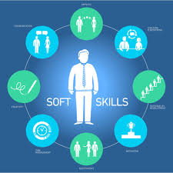
What are Soft skills
Soft skills are the personal attributes that enhance an individual’s interactions, job performance and career prospects. Unlike hard skills, which tend to be specific to a certain type of task or activity, soft skills are broadly applicable.Soft skills are sometimes broken down into personal attributes, such as optimism,common sense ,responsibility,a sense of humour,integrity,time-management,motivation ,interpersonal abilities,empathy,leadership,communication, good manners, sociability the ability to teach to mention a few.

Slide 13
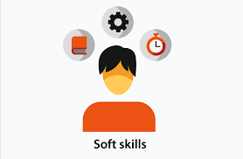
Why soft skills…
It’s often said that hard skills will get one to get a job but one needs soft skills to keep that job.
Technical and job-related skills are a must, but they are not sufficient when it comes to progressing up the ladder of profession or success.
Soft skills are very important in life. It is essential to be technically sound, but one should also have the ability to convey the idea to the masses in the simplest possible manner.
Planning is necessary but execution is also equally important. And it takes soft skills to execute any idea because it involves dealing with others directly.

Slide 14
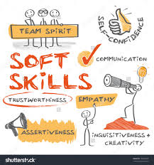
Why Soft skills…
The technical abilities are important to get good job. However, when it comes to growing , it is the soft skills that matters more.

Slide 15
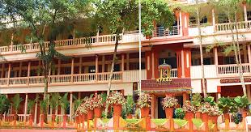
NVKSD’s Mission
Realising the importance of Soft skills especially its impact on profesional development,we in our institution is concentrating in enhancing soft skills among our prosepective teachers,prospective teacher educators and research scholars.As the area is very broad ,moving towards,as our first step we are helping our students to improve their communication skills,which is a competent skill among soft skills.For that we have prepared a module on communication skills exclusively by us and a sample is presented here with .

Slide 16
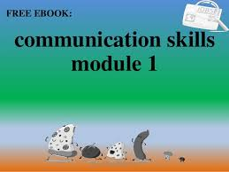
Communication module

Slide 17
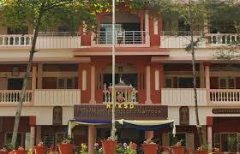
Mission Continues…
After Communication Skills,we are underway preparing Modules for other soft skills like interpersonal skill…
Our Mission Softskills continues…
Moreover ,we are an autonomous institution having fortunate enough to design our syllabi to some possible extent.Hence,with an intention to make our students capable enough to meet with competitive world and life outside,We have in our syllubus,
Life Skills Education and Societal based Life skills Projects.

Slide 18
Hope point justified…
Hence Soft skills are an integral change Maker for Capacity Building of Teachers
It helps in building a stronger pipeline to build up a future India through it teachers.
Thus it plays a vital role in building a foundation for lifelong learning and well-being for each and every

Slide 19
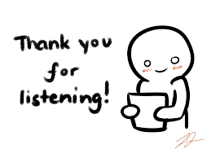
For the Patient Listening…
Here I would like to stop my presentation…and Thanking IUCTE for giving me this opportunity to project my views on this seemingly simpler but heavy topic and thanking all the esteemed for your patient listening…

