Slide 1
SKILL OF BACKBOARD WRITING

Slide 2
INTRODUCTION
The skill of using backboard may be defined as a skill or technique that helps a teacher to use BB in the teaching-learning process as effectively as possible for the proper realization of the stipulated teaching-learning objectives

Slide 3
The Components of the skill of Black board are:
1.LEGIBILITY (L) : Legible handwriting of the teacher on the back board draw the attention of the learners and encourages them to improve their hand writing.
The teacher should ensure that a clear distinction is ensured between words and letters

Slide 4
legibility in writing letters

Slide 5
Illegible hand writing (illegible hand writing irritates the learners and results in maximum mistakes)

Slide 6
2.Size and Allignment (SA):
The size of the letters on the BB should be uniform and according to the class level.The letters and words should be in a straight line.Equal distance should be provided between two lines.No overwriting shall be made and should not look over crowded.

Slide 7
No over crowdedness

Slide 8
Eg.Size of the letters should be uniform and equal distance betweeen lines

Slide 9
Eg. incorrect writing of sentences

Slide 10
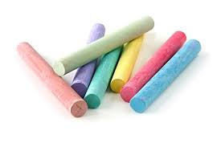
3.Highlighting main points(HMP):
The teacher should underline the main points or words on the BB.
Coloured chalks can be used to draw learners attention.

Slide 11
4.Utilization of the space.(US)
Important words or statements should be written on the BB for the proper utilization of space.
Only necessary materials should be retained and unnecessary words should be rubbed off.

Slide 12
5.Correctness(C)
The teacher should be careful about correct spelling, punctuation, grammar etc in constructing sentences on the BB.

Slide 13
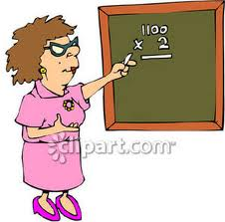
6.Position of the teacher
At the time of writing the teacher should stand on the side of the BB with an angle of 45*,so that the written work is visible to learners.

Slide 14
Incorrect position while writing on BB

Slide 15
7.Eye contact with the pupils(ECP)
The teacher should maintain eye contact with his learners at the time of writing .It maintains discipline and attention of the learners.

Slide 16
Eye contact with pupils

Slide 17
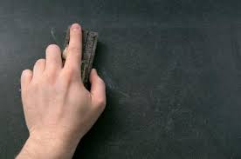
8.Cleaning of BB
Teacher should clean the BB from top to bottom and do not spread dust in the room. After completion of the lesson the teacher should clean the entire BB before leaving the classroom.

Slide 18
Precautions for BB work
1.Predecide the things to be written on the BB.
Check the material required like chalks,duster,scale.
Chalk stucks should not make noise
Press the chalk and then write.
A pointer should be used to focus points
Read the things written on the BB

Slide 19
B-Be kind and use me
L-Lay out the PLAN in advance
A-Arrangement of BB
C-Check LAG and CERCA
(Light,Angle,Glare)(Chalk of all colours,Eraser,Ruler,Cane,Any other templates)
K-keep it clean()neat,orderly)

Slide 20
B-Be judicious
O- order-SOS(stand on side)
A-Attraction by CUP(colour, capital letters, underline,pointer)
R-writing with a BRUSH(bright,readable,uniform,straight,horizontal)
D-Drawing with a PEN(purposeful,easy,neat)

Slide 21
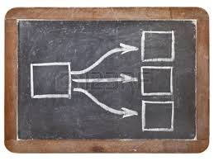
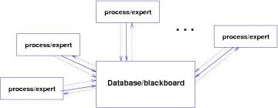
Some suggested entries on BB

